Slide 1

界面设计
TOP GROUPS
小组成员：刘东 胡伟凡 黎亦汛 庞增冠
BY：华师F4

Slide 2

1.登录及注册UI
Background
2. 日历UI
Feasibility report on project implementation
目录
contents
3.账本UI
Product Orientation and Targets
4.空间UI
Product content planning
5.用户UI
Product promotion and operation

Slide 3

01
登录及注册UI
Background

Slide 4

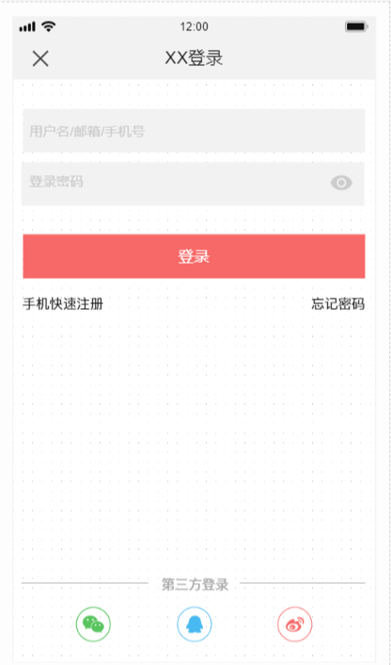
登录及注册界面
Backgrounds

Slide 5
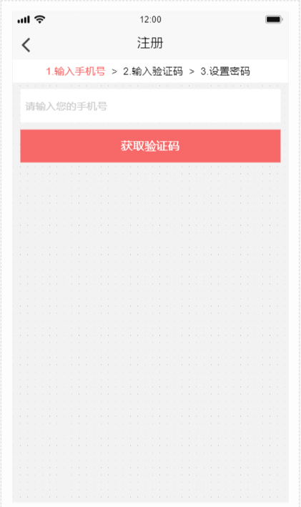
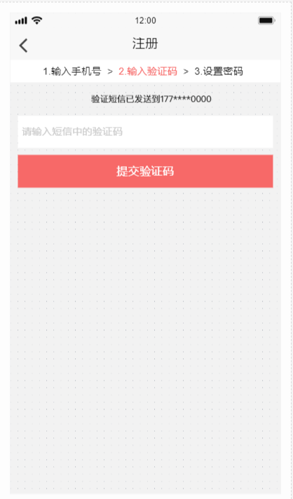
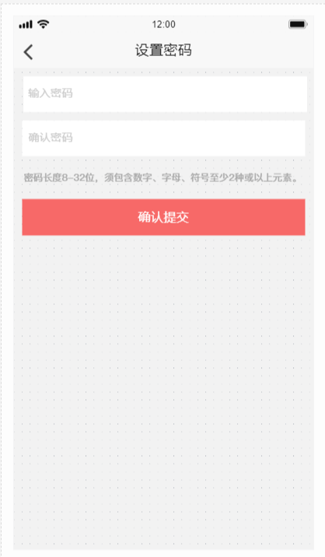
登录及注册界面
Backgrounds

Slide 6
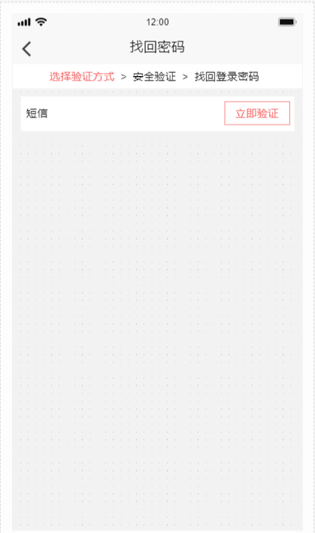
登录及注册界面
Backgrounds

Slide 7
Feasibility report on project implementation
02
日历UI
Feasibility report on project implementation

Slide 8
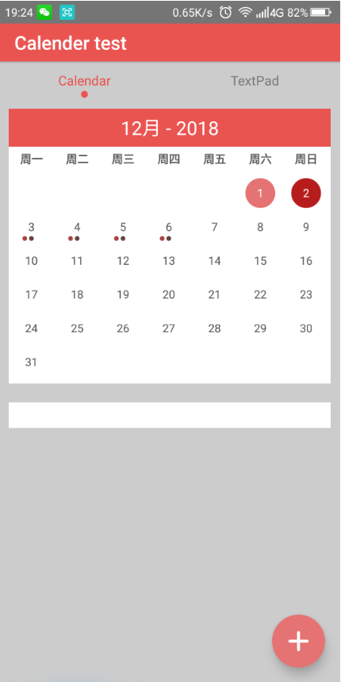
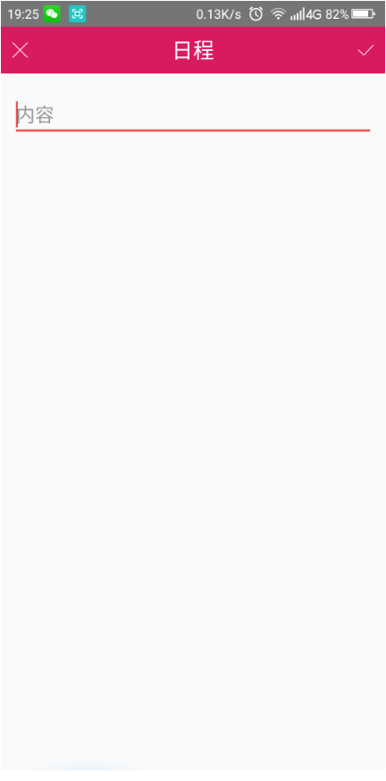
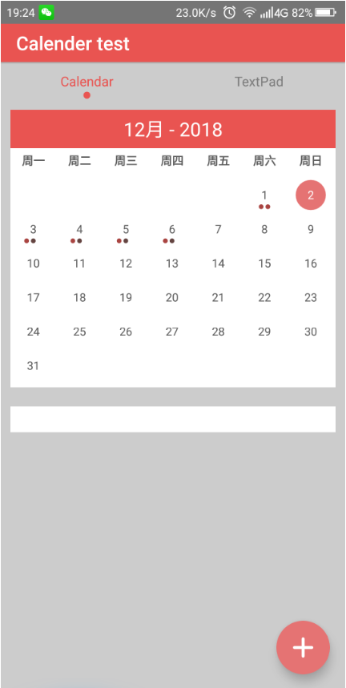
2.日历UI
Industry Market Analysis

Slide 9
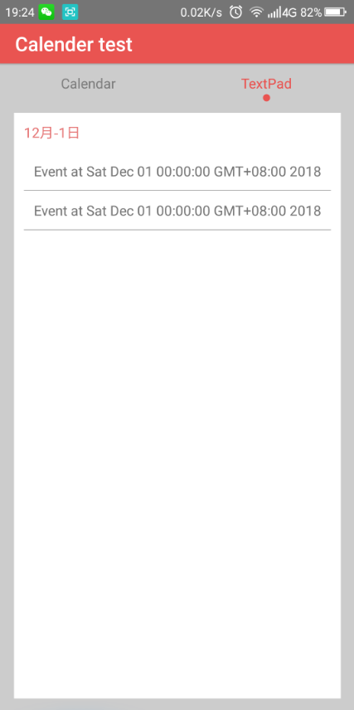
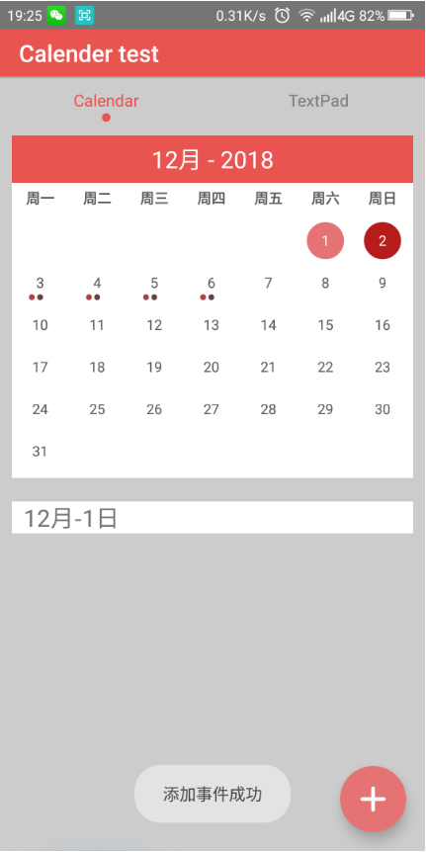
2.日历UI
Industry Market Analysis

Slide 10
03
账本UI
Product Orientation and Targets

Slide 11
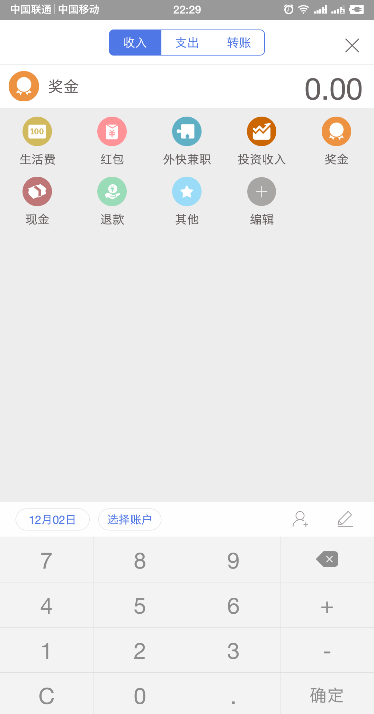
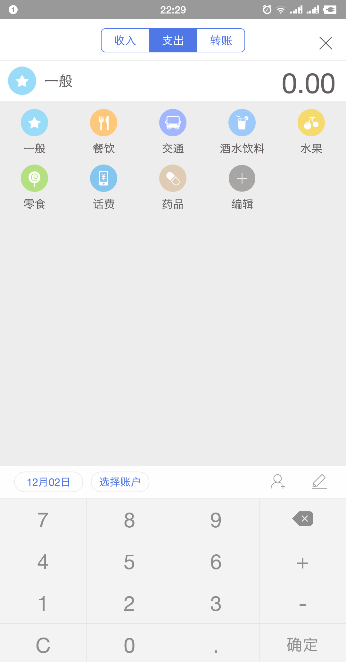
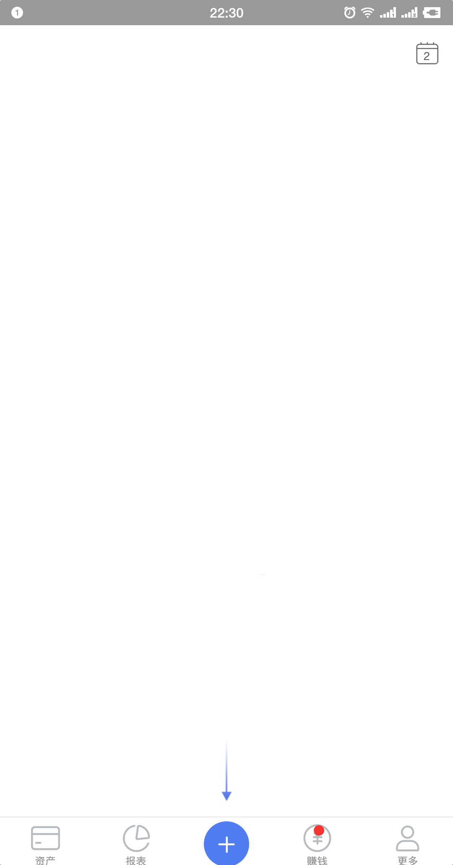
3.账本UI
Industry Market Analysis

Slide 12
04
空间UI
Product content planning

Slide 13
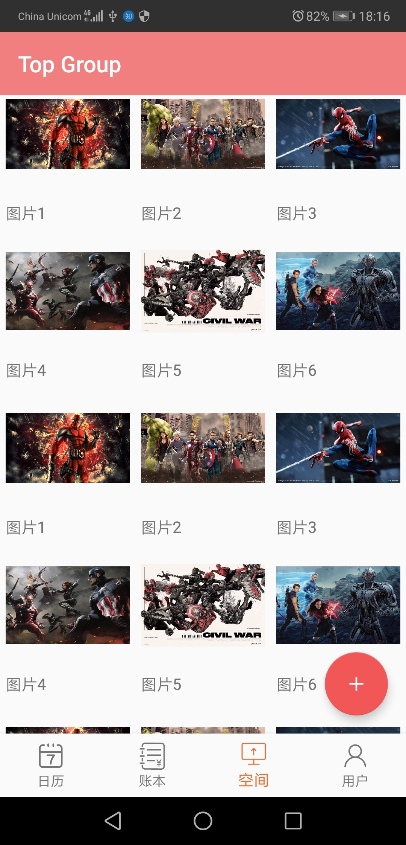
4.空间UI
Industry Market Analysis

Slide 14
05
用户UI
Product content planning

Slide 15
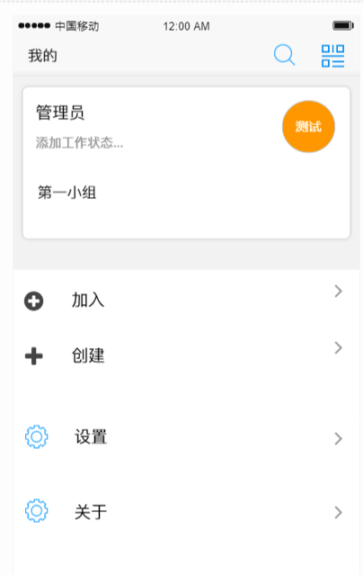
5.用户UI
Industry Market Analysis

Slide 16
ThankS
感谢您的观看
小组成员：刘东 胡伟凡 黎亦汛 庞增冠
BY：华师F4

